Slide 1

Pilot study comparing self-collected low vaginal swab with clinician taken high vaginal swab for the detection of candida and bacterial vaginosis.
Pam Barnes
Specialty Doctor in Sexual Health
New Croft Centre
Newcastle upon Tyne

Slide 2
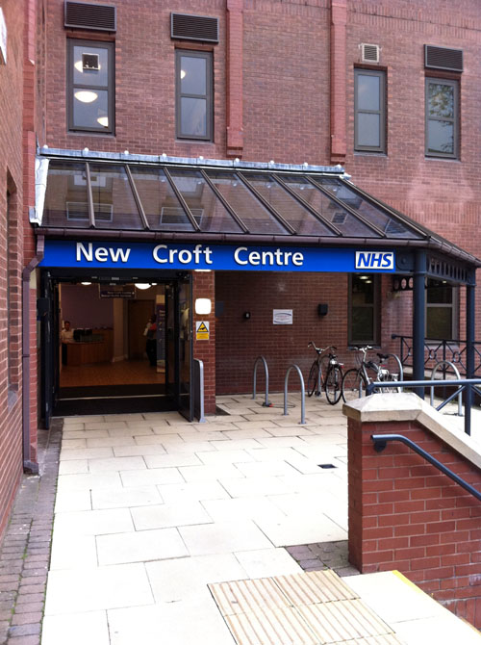
Back ground to the study
Hypothesis that self taken swabs would be as good as clinician taken swabs for the diagnosis of BV and VVC.
Particularly relevant to non-GU services
Provide evidence that could change practice.

Slide 3
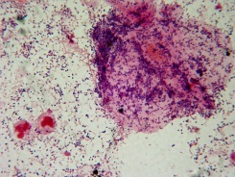
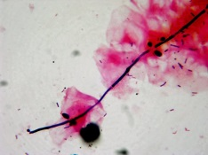
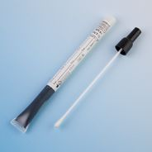

Study Design
Case controlled study with the patient acting as her own control
Symptom criteria:
  Change in normal vaginal discharge
  Vulval irritation - Vulval pain
  Offensive genital smell.
Participants took a self-collected LVS prior to speculum insertion and vaginal examination, during which a clinician took a HVS.
Main outcome measure: Diagnosis of BV or VVC infection with samples analysed in a microbiology department using both microscopy and
culture.

Slide 4
Correlation of symptoms with diagnosis
Of the 104 women enrolled 97 had complete data for both BV and VVC

Slide 5
Results (using laboratory diagnosis from clinician taken HVS as the reference standard)
Data from 99 women for VVC and 97 women for BV
45 women were diagnosed with VVC of which LVS detected 43.
26 women were diagnosed with BV of which LVS detected 23.
5 women had both VVC and BV - LVS detected both in 4 .
31 had neither BV nor Candida – of which LVS was negative in 26.
11 women had an STI (8-Chlamydia, 2-GC+Chlamydia, 2-HSV)

Slide 6
Statistical analysis- Cohen's Kappa Coefficient
Value of Kappa | Level of Agreement | % of Data that are Reliable
0 – 0.20 | None | 0–4%
0.21– 0.39 | Minimal | 4–15%
0.40 – 0.59 | Weak | 15–35%
0.60 – 0.79 | Moderate | 35–63%
0.80 – 0.90 | Strong | 64–81%
Above 0.90 | Almost Perfect | 82–100%
Kappa coefficient looks at the level of agreement between 2 different observers.
Calculates the percentage probability that this is not due to chance.
.

Slide 7
Kappa Score for Bacterial Vaginosis
Self –collected LVS | Clinician taken HVS BV not diagnosed | Clinician taken HVS BV diagnosed | Grand total
LVS-BV not detected | 68 | 3 | 71
LVS-BV detected | 3 | 23 | 26
Grand total | 71 | 26 | 97
Number of observed agreements: 91 ( 93.81% of the observations)
Number of agreements expected by chance: 58.9 ( 60.76% of the observations)
Kappa= 0.842 SE of kappa = 0.062

Slide 8
Kappa Score for Vulvo-vaginal Candidiasis
Self-collected LVS | Clinician taken HVS VVC not diagnosed | Clinician taken HVS VVC diagnosed | Grand total
LVS- VVC not detected | 50 | 2 | 52
LVS- VVC detected | 4 | 43 | 47
Grand total | 54 | 45 | 99
Number of observed agreements: 93 ( 93.94% of the observations)
Number of agreements expected by chance: 49.7 ( 50.23% of the observations)
Kappa= 0.878 SE of kappa = 0.048

Slide 9
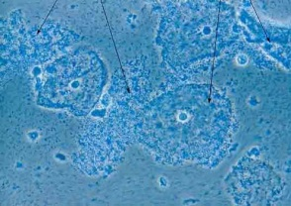

Interpretation of results
VVC Kappa coefficient 0.878 = Strong agreement!
BV Kappa coefficient 0.842 = Strong agreement!
Self collected LVS | Sensitivity | 95% CI | Specificity | 95% CI | PPV | NPV
VVC detection | 0.955 | 0.836-0.992 | 0.926 | 0.813-0.976 | 0.915 | 0.962
BV detection | 0.885 | 0.687-0.970 | 0.958 | 0.873-0.990 | 0.885 | 0.957

Slide 10
Conclusions
This study shows a strong correlation between self-collected and physician collected vaginal swabs in the diagnosis of VVC and BV.
Although originally designed as a pilot study our Kappa scores indicate that this study is sufficiently powered to be valid.
Patient perception of their discharge is not a reliable indicator of likely pathology.
Self-collected LVS are not a substitute for genital examination but in a time constrained service LVS appears to have equivalent detection rates to HVS.

