Slide 1
Human papillomavirus vaccination and STI screening in men who have sex with men
Dr John McSorley
London North West Healthcare
NHS Trust

Slide 2

HPV vaccination in MSM: Background
JCVI advises that a targeted HPV vaccination programme with a course of three doses for MSM aged up to 45 who attend GUM and HIV clinics should be undertaken, subject to procurement of the vaccine and delivery of the programme at a cost-effective price (2015)
JCVI considers that there may be considerable benefit in offering the HPV vaccine to other individuals who have a similar risk profile to that seen in the 16 to 40 year old GUM attending MSM population, including some MSM over 45, sex workers, HIV+ve women, and HIV+ve men.
Clinicians are able to offer vaccinations outside of the national programme using individual clinical judgement, and HPV vaccination could therefore be considered for such individuals on a case-by-case basis.

Slide 3
HPV4 in MSM: LNWH programme
We observed increasing numbers of STIs in MSM
We observed increasing numbers of MSM
MSM represented 2% of clinic attendees
We developed a “care bundle” for MSM See “Your Journey”
We introduced HPV4 vaccination for younger MSM (<27yrs) into our sexual health services in 2012

Slide 4
HPV4 in MSM: LNWH: Aims
To deliver 3 doses HPV4 vaccine to MSM <27
To increase engagement and STI testing by younger MSM attending Integrated Sexual Health Services

Slide 5
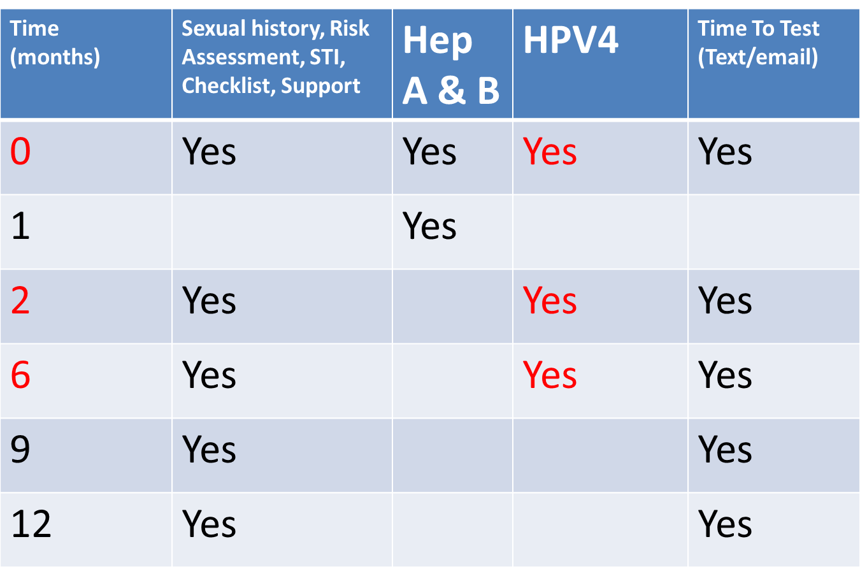
HPV4 in MSM: LNWH: Method 1

Slide 6
HPV4 in MSM: LNWH: Method 2
HPV4 was offered at Time 0, 2-4 and 6-12months, with STI testing, clinic call/recall, and care and support as appropriate (Your Journey)
We conducted a retrospective electronic case note review of all eligible MSM to end 2015
STI testing and outcomes at vaccine visits are reported
Vaccine completion rates are censored at 1 year
HPV4 vaccination is not

Slide 7

HPV4 in MSM: LNWH: Results 1
 | Year 1 (2013) No. (%) | Year 2 (2014) No. (%) | Year 3 (2015) No. (%)
Dose 1 | 239 | 255 | 399
Dose 2 | 187 (78%) | 194 (76%) | 243/324* (75%)
Dose 3 | 148 (62%) | 140 (56%) | 111/200* (56%)
* 2015 figures are pro rata: where 12 months has passed.
Completion rates rise as clients continue to receive HPV4 at later attendances

Slide 8
HPV4 in MSM: LNWH: Results 2
 | STI screen / Total No. (%) | STI +ve / Total No. (%) | STI +ve/ Total No. Tested (%)
Dose 1 | 880/893 (99%) | 283/893 (32%) | 283/880 (32%)
Dose 2 | 556/658 (84%) | 77/658 (12%) | 77/556 (14%)
Dose 3 | 372/427 (87%) | 60/427 (14%) | 60/372 (16%)

Slide 9
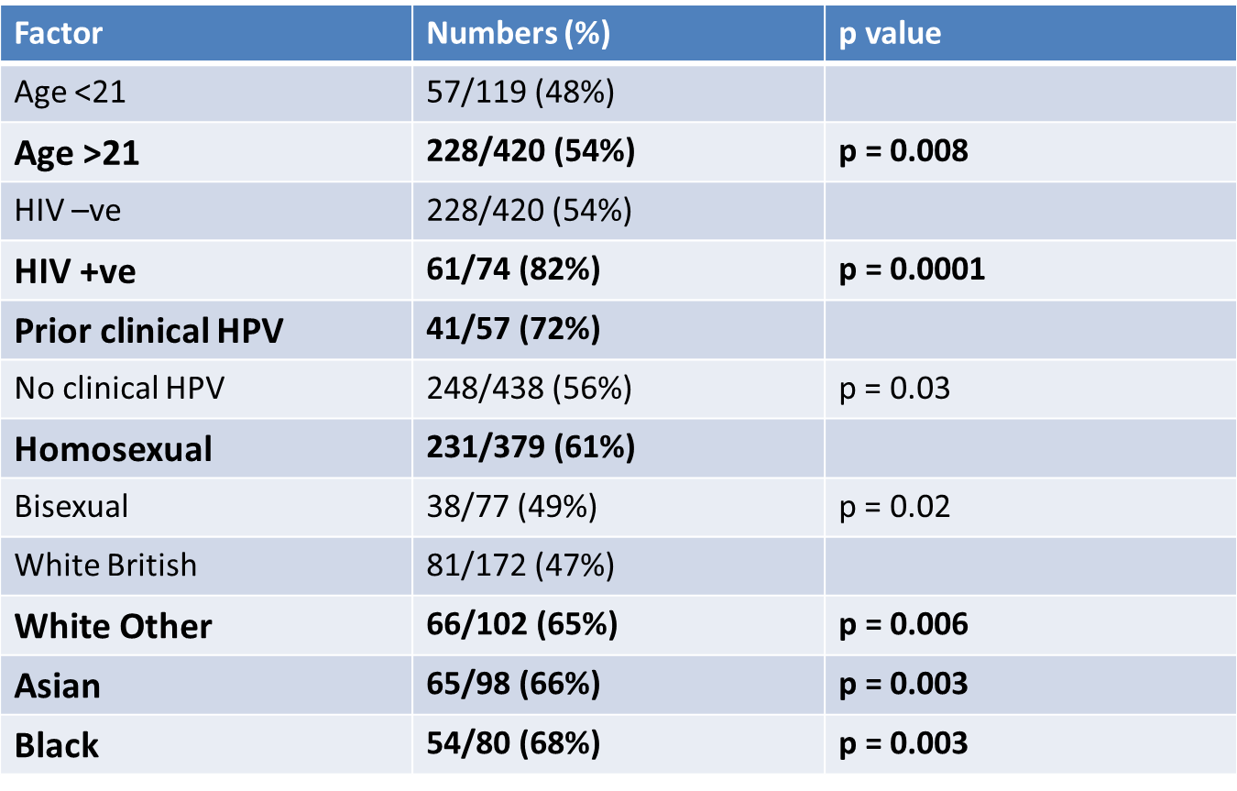

HPV4 in MSM: LNWH: Results 3
Factors associated with 3 dose completion within 1 year

Slide 10
HPV4 in MSM: LNWH: Clinic Activity
Percentage of Clinic Attendees who are MSM
Percentage of MSM Clinic Attendees who are from Black Asian or Minority Ethnic (BAME) background

Slide 11
HPV4 in MSM: LNWH: Conclusions
We observed 3 dose completion rates commensurate with expected for a targeted vaccination programme
HPV4 Completion was associated with older age, HIV status, prior experience of HPV disease, MSM self identifying as homosexual and non white british ethnicities.
We observed high uptake of concurrent STI testing
We observed high rates of incident STI

Slide 12
HPV4 in MSM: LNWH: Discussion
HPV vaccination within sexual health services is an effective engagement strategy for young MSM
Services should maximise the opportunity to address the holistic needs of young MSM that an HPV4 programme will represent rather than seeking to deliver a vaccine programme at minimal cost

