Slide 1
Rapid fall in quadrivalent vaccine targeted human papillomavirus genotypes in heterosexual men following the Australian female HPV vaccination programme: an observational study from 2004 to 2015
Dr Eric Chow (echow@mshc.org.au)
Melbourne Sexual Health Centre, Alfred Health
Central Clinical School, Monash University

Slide 2
Acknowledgment
Melbourne Sexual Health Centre
Christopher Fairley
Catriona Bradshaw
Marcus Chen
Glenda Fehler
The Royal Women’s Hospital
Dorothy Machalek
Sepehr Tabrizi
Jennifer Dainelewski
Suzanne Garland
Funding
National Health and Medical Research Council Program (NHMRC)
Disclosure
EC has received educational grants from Seqirus and bioCSL to assist with education, training, and academic purposes in human papillomavirus.

Slide 3
HPV vaccination programme in Australia
Aged 12-13
Catch-up programme aged 13-26 from 2007 to 2009
Aged 12-13
Catch-up programme aged 14-15 until Dec 2014
April 2007
Feb 2013

Slide 4
HPV vaccines
Bivalent | Cervarix®
Quadrivalent | Qardasil®
9-valent | Qardasil® 9
16
18
16
18
6
11
16
18
6
11
31
33
45
52
58
Numerous studies have shown a large reduction on genital warts and vaccine-related HPVs in females¹⁻⁴
No studies examined HPV in men before and after the female programme
¹ Chow EP et al. Lancet Inf Dis. 2015; 15: 1314-1323
² Chow EP et al. Sex Trans Inf. 2015; 91: 214-219
³Ali H et al. BMJ. 2013: 346: f2032.
⁴Tabrizi SN et al. Lancet Inf Dis. 2014; 14: 958-66

Slide 5
Aim
To examine the annual trends of HPV genotypes prevalence among sexually active young men over an 11-year period, from 2004 to 2015.
3 years before and 8 years after the female HPV programme

Slide 6
Methods
Melbourne Sexual Health Centre (MSHC), Victoria, Australia
Retrospective observational study: 2004 – 2015
Stored chlamydia positive samples
Heterosexual men aged ≤25 who had a positive results for urethral chlamydia (urine and urethral swab)
Demographic characteristics (age, country of birth), sexual behavioural data (number of partners, condom use)

Slide 7
Analyses
HPV DNA extracted from stored samples
PapType HPV assay was performed to detect 14 high-risk HPV genotypes (16, 18, 31, 33, 35, 39, 45, 51, 52, 56, 58, 59, 66, and 68) and two low-risk genotypes (6 and 11).
Stratified by Australian financial years (July to June)
Australian-born vs overseas-born
Herd protection in Australian-born men due to sexual mixing¹
¹ Chow EP et al. Sex Health. 2016. Accepted.

Slide 8
HPV prevalence analyses
Any HPV genotypes (6, 11, 16, 18, 31, 33, 35, 39, 45, 51, 52, 56, 58, 59, 66, and 68)
4 vaccine-targeted HPV genotypes (6, 11, 16, 18)
6, 11
16, 18
Non-vaccine-targeted high-risk HPV genotypes (31, 33, 35, 39, 45, 51, 52, 56, 58, 59, 66, or 68)

Slide 9
Results
1466 men were included
1428 (97%) urine specimens
38 (3%) urethral swab specimens
633 (43%) Australian-born men
768 (52%) Overseas-born men
65 (4%) had an unknown place of birth
No significant differences in HPV detection (P=0.109)

Slide 10
Australian-born men
Female vaccination
programme (Apr, 2007)
Male vaccination
programme (Feb, 2013)
(P=0.881)
Median number of male partner: 3 [04/05] to 5 [14/15]; p=0.001
100% condom in P12M: ~5%; p_{trend}=0.790
(P=0.003)
(P<0.001)
(P=0.007)
Significant decline in all 4 vaccine-targeted genotypes (6, 11, 16, 18)
13%
1%
0%

Slide 11
Overseas-born men
Female vaccination
programme (Apr, 2007)
Male vaccination
programme (Feb, 2013)
Median number of male partner: 3 [04/05] to 5 [14/15]; p=0.014
100% condom in P12M: ~5%; p_{trend}=0.889
(P=0.325)
(P=0.319)
Significant decline in genotypes 16/18 but NOT in 6/11
(P=0.014)
(P=0.004)
WHY???

Slide 12
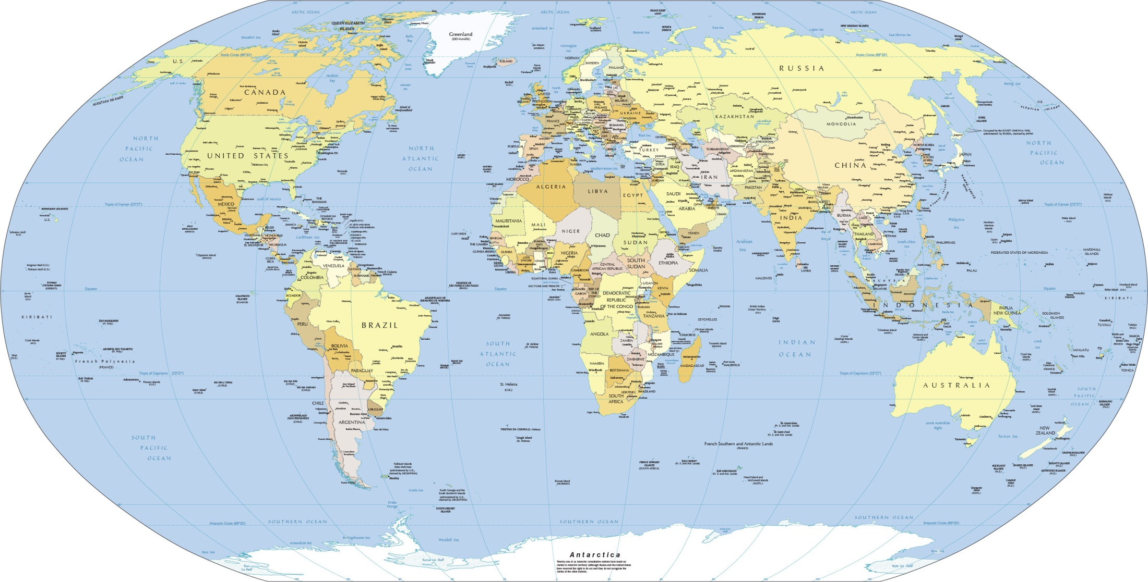
Cook Islands
Northern Ireland
Scotland
National bivalent vaccination programme
England
Wales
Netherlands

Slide 13
Cook Islands
Northern Ireland
Scotland
England
Arrived Australia within 2 years
Wales
Netherlands

Slide 14
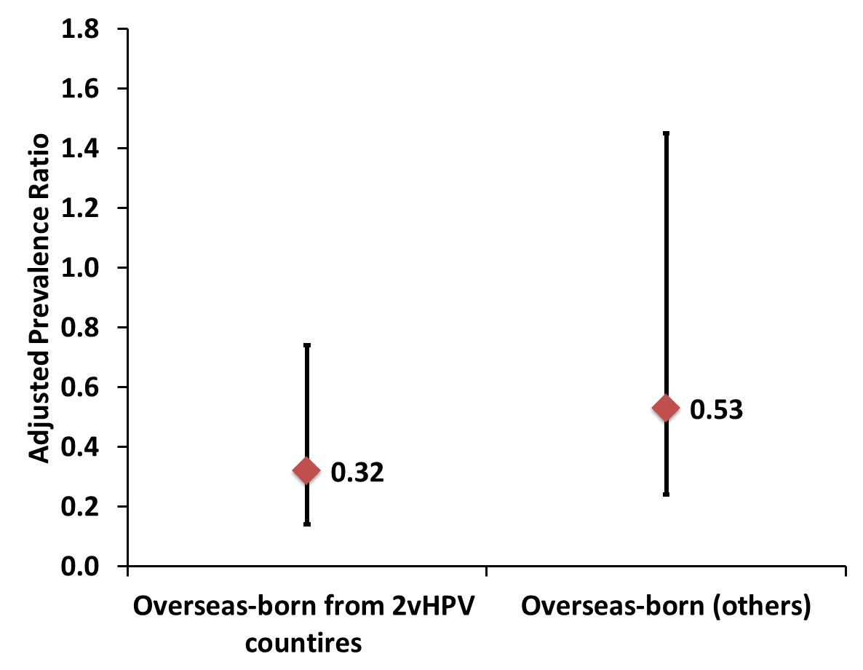
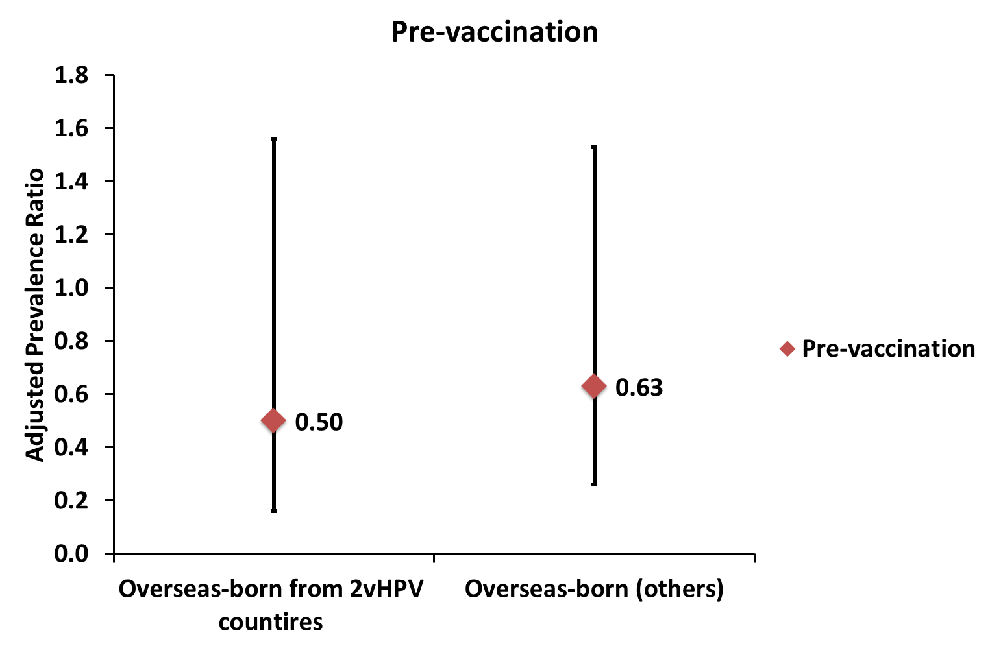
Overseas-born men
16/18
6/11
P=0.234 P=0.306
P=0.006 P=0.130

Slide 15
Take home messages
With a high female vaccination coverage (84%), large reduction in genotypes 6/11/16/18 among mainly unvaccinated Australian-born men
Evidence of herd protection from the female HPV programme
Decline in 16/18 but not in 6/11 among overseas-born men predominantly from countries with a bivalent vaccine programme
Evidence of herd protection for genotypes 16 and 18 from their vaccinated female partners in their own countries

Slide 16
Chow EP, et al. The Lancet Infectious Diseases. Online 6 June 2016

Slide 17
Schiffman M, Saraiya M. The Lancet Infectious Diseases. Online 6 June 2016

