Slide 1
Sexual function problems in British 16-21 year olds: Cause for concern?
Kirstin R Mitchell
MRC/CSO Social and Public Health Sciences Unit, Institute of Health and Wellbeing, University of Glasgow
Centre for Sexual Health, London School of Hygiene and Tropical Medicine
Co-authors: Rebecca Geary, Cynthia Graham, Soazig Clifton, Catherine H Mercer, Ruth Lewis, Wendy Macdowall, Jessica Datta, Anne M Johnson, Kaye Wellings

Slide 2
DEFINITION
Sexual function is: an individual’s ability to respond sexually or to experience sexual pleasure (DSM-5)
Notes:
Sexual function problems are those that interfere with this response…

Slide 3
What professionals say; what young people say
PREVENT HARM, AVOID STIS, AVOID UNPLANNED PREGNANCY, AVOID NON-CONSENSUAL SEX
ANXIETY ABOUT SEXUAL ORIENTATION, ANXIETY ABOUT GENDER IDENTITY, SOCIAL PRESSURES AND NORMS
Notes:
Professional concerned to prevent the harms of sex, primarily unplanned pregnancy and STI transmission (1-3) and, increasingly, non-consensual sex.
Meanwhile…..young people concerned with issues affecting their sexual well-being including: anxiety about sexual orientation or gender identity; social pressure to consent to activities they dislike or find painful; struggle against norms that make it difficult to admit to experiences that are less than ideal.

Slide 4
Absence of data permits silence
Reinforces the belief that sexual function and well-being are less relevant to young people
Limits efforts to address sexual health holistically
Notes:
permits this silence

Slide 5
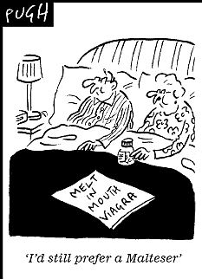
Dailymail online©
Assumptions about sexual dysfunction
Notes:
Assumption is that sexual dysfunction only affects older people
Troubling absence of Sexual function from the policy discourse on young people’s sexual health.
The omission is troubling, given the link between low sexual function and indicators of risk (including higher partner numbers, paying for sex, non-consensual sex and STI diagnosis).

Slide 6
Methods
Data from a national probability survey of 15,162 British men and women (Natsal-3), undertaken from 2010-2012 using computer-assisted self-interviews (CASI).
Complex survey analyses of data from participants aged 16-21 (854 men and 1021 women sexually active in the last year; 262 men and 255 women sexually experienced but not active in the last year).

Slide 7
Measures
Items from the Natsal-SF (validated 17 item measure designed for population surveys)
8 sexual problems lasting 3 months or more
Distress about problem
Distress about sex life, avoidance of sex due to difficulties, satisfaction with sex life

Slide 8
Results

Slide 9
Sexual function problems, sexually active men aged 16-21
 | % reporting each sexual function problem |  | % reporting each problem and distress about it |  | Of those reporting each sexual function problem, % fairly or very distressed about it
Denominators* | 854, 610 |  | 854, 610 |  | 281, 204*
 | Percent | 95% C.I. | Percent | 95% C.I. | Percent | 95% C.I.
Lacked interest in having sex | 10.50% | (8.1-13.5) | 1.40% | (0.8-2.5) | 13.20% | [7.2-22.8]
Lacked enjoyment in sex | 5.40% | (4.0-7.3) | 0.90% | (0.4-1.7) | 16.20% | [8.1-29.8]
Felt anxious during sex | 4.80% | (3.5-6.6) | 1.50% | (0.8-2.7) | 30.40% | [17.9-46.6]
Felt physical pain as a result of sex | 1.90% | (1.1-3.4) | 0.20% | (0.1-0.9) | 11.30% | [2.5-39.1]
No excitement or arousal during sex | 3.20% | (2.1-4.8) | 0.80% | (0.4-2.0) | 25.90% | [11.5-48.4]
Difficulty in reaching climax | 8.30% | (6.4-10.8) | 1.60% | (0.8-3.0) | 19.20% | [10.5-32.4]
Reached climax too quickly | 13.20% | (11.0-15.7) | 4.50% | (3.2-6.3) | 34.20% | [25.5-44.1]
Difficulty getting/keeping an erection | 7.80% | (6.0-10.2) | 3.30% | (2.2-4.9) | 42.10% | [29.1-56.4]
Experienced one or more of these | 33.80% | (30.2-37.7) | 9.10% | (7.2-11.4) | 26.90% | [21.5-33.0]
Sought help or advice for sex life | 26.00% | (22.9-29.5)
* Denominator varies for each individual sexual function problem in this column. The unweighted and weighted denominator listed is for those that experienced one or more of these problems.
Notes:
72% of age group were sexually active.
Distressing sexual function problems (>3months in last year) were reported by 9.1% of men and 13.4% of women.
Most common among men was reaching a climax too quickly (4.5%) and among women, difficulty reaching climax at all (6.3%).

Slide 10
Sexual function problems, sexually active women aged 16-21
 | % reporting each sexual function problem |  | % reporting each problem and distress about it |  | Of those reporting each sexual function problem, % fairly or very distressed about it
Denominators* | 1021, 553 |  | 1021, 553 |  | 449, 242*
 | Percent | 95% C.I. | Percent | 95% C.I. | Percent | 95% C.I.
Lacked interest in having sex | 22.00% | (19.3-25.0) | 5.30% | (4.0-7.0) | 24.00% | [18.4-30.6]
Lacked enjoyment in sex | 9.80% | (7.9-12.1) | 2.80% | (1.9-4.1) | 28.40% | [19.8-39.0]
Felt anxious during sex | 8.00% | (6.3-10.2) | 2.80% | (1.9-4.1) | 34.70% | [24.2-47.0]
Felt physical pain as a result of sex | 9.00% | (7.3-11.0) | 3.20% | (2.3-4.5) | 35.90% | [26.7-46.2]
No excitement or arousal during sex | 8.00% | (6.2-10.1) | 2.50% | (1.6-3.9) | 31.60% | [21.2-44.3]
Difficulty in reaching climax | 21.30% | (18.6-24.3) | 6.30% | (4.9-8.2) | 29.70% | [23.4-36.9]
Reached climax too quickly | 3.90% | (2.7-5.5) | 0.40% | (0.2-1.1) | 10.80% | [4.0-26.3]
Uncomfortably dry vagina during sex | 8.50% | (6.7-10.6) | 2.20% | (1.5-3.4) | 26.20% | [17.5-37.2]
Experienced one or more of these | 44.40% | (41.1-47.8) | 13.40% | (11.3-15.9) | 30.20% | [25.7-35.1]
Sought help or advice for sex life | 36.30% | (33.1-39.7)
Denominator varies for each individual sexual function problem in this column.
The unweighted and weighted denominator listed is for those that experienced one or more of these problems.

Slide 11
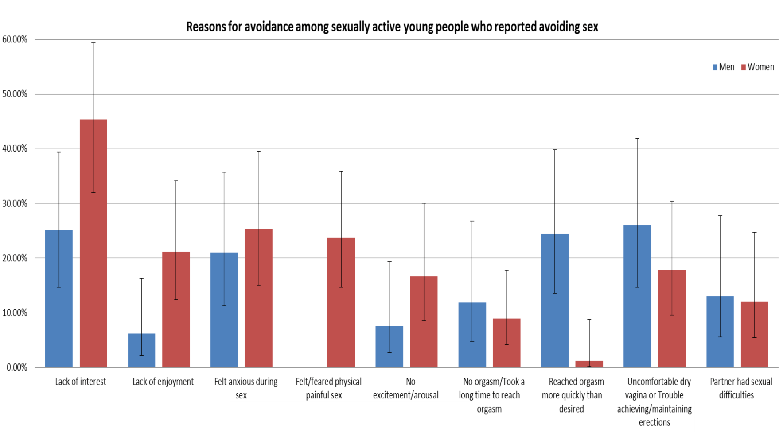
Notes:
About 6% of sexually active men and women said they had avoided sex because of a sexual difficulty. What were the most common reasons for avoiding sex?

Slide 12
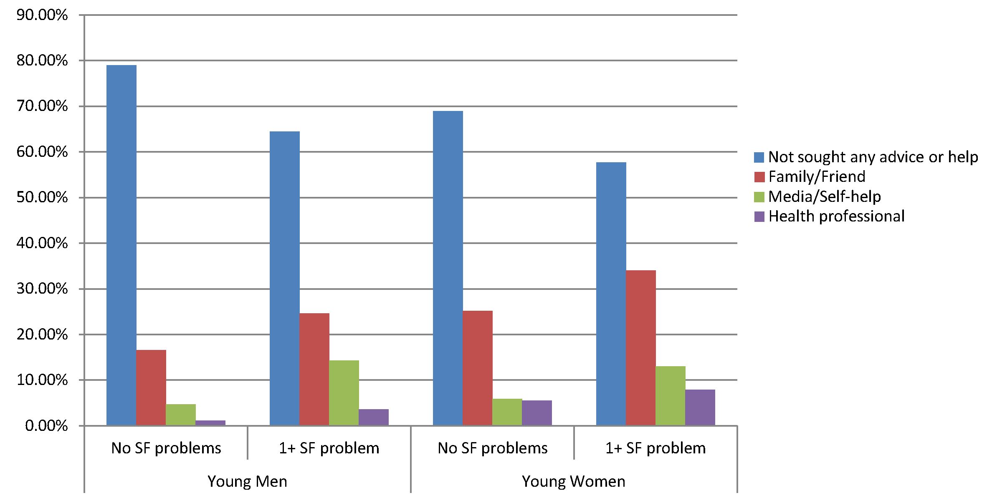
Help-seeking among sexually active young people with and without Sexual Function problems
Notes:
The majority of young people experiencing problems did not seek help, and those that did rarely sought out professionals.

Slide 13
Distress, avoidance and dissatisfaction among non-sexually active young people
 | Men |  | Women
 | Percent | 95% C.I. | Percent |  | 95% C.I.
Denominators | 262, 165 |  | 255, 138
Distressed or worried about sex life | 17.40% | (12.8-23.4) | 12.00% | (8.3-17.2)
Avoided sex because of own or partner's sexual difficulties | 10.10% | (5.5-17.9) | 10.70% | (5.4-20.1)
Satisfied with sex life | 34.60% | (28.5-41.3) | 32.20% | (26.2-38.7)
Notes:
Around 6% of those currently sexually active, and 10% of those not so, reported avoiding sex because of sexual function problems.

Slide 14
Cause for concern?

Slide 15
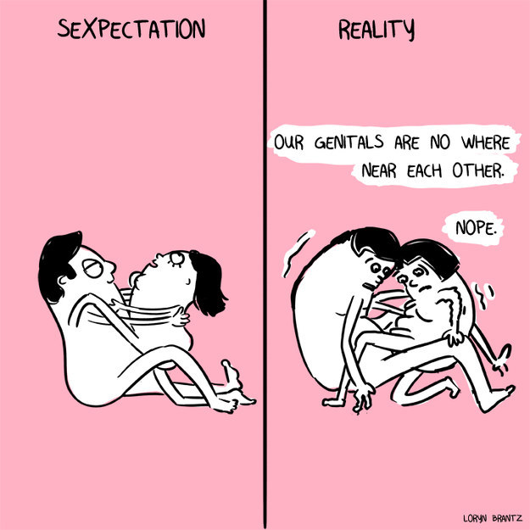
Practice effect?
Notes:
O’Sullivan and colleagues: in young men, a longer period of sexual experience was associated with better erectile functioning and greater satisfaction with intercourse.

Slide 16
Or the start of life-long difficulties?
Notes:
BUT: a proportion of adults with sexual function problems report lifelong symptoms (i.e. appearing at or before time of their sexual debut and not subsiding)
A number of factors contributing to sexual difficulties are typically shaped in childhood and adolescence. These include inadequate sex education; difficulty in communicating about sex; anxiety about one’s body or sexuality; and confusion or shame about one’s sexual orientation or desires .
Sexual difficulties may also reflect the struggle to achieve positive sexuality within the confines of restrictive and gendered social norms, for instance, an acceptance that women should expect and endure pain

Slide 17
What young people want…
Wish I’d known more about sexual feelings, emotions and relationships
Wish I’d known how to make sex more satisfying
Notes:
Over 25 years since Michelle Fine’s essay on the missing discourse of desire in sex education (34), young people continue to perceive a gap in their knowledge relating to psychosocial aspects of sex, and often report feeling ill-equipped to manage sexual intimacy.
So young people say they want to talk about pleasure, non-penetrative alternatives to intercourse and power relations in sexual relationships
Natsal-3 data (Tanton, date): 42% of men and 47% of women wish they had known more about psycho-sexual topics at the time they first felt ready to have sex, including nearly 20% of men and 15% of women who wished they had known how to make sex more satisfying
Allen 2008: students aged 16-19 ranked ‘how to make sexual activity more enjoyable for both partners’ and ‘emotions in relationships’ among the top five topics they wished to know more about in school sex education (24).

Slide 18
Sex education often fails to meet needs
Sex Ed Curriculum
Filling the gap
Conception
SEXUALLY TRANSMITTED INFECTIONS
RISK
The law
Using condoms
Friends
Media
Pornography

Slide 19
Rationale for talking about pleasure
goals relating to sexual satisfaction and pleasure shape both risk taking and risk-reduction practices
Good sexual health in adolescents is associated with risk reduction behaviours, such as condom use and sexual abstinence.
Notes:
For instance, fears about erectile functioning among young men have been shown to contribute to resistance to condom use (20) as well as to inconsistent us
e (21).

Slide 20
Strategies……
Sex education: Debunk myths, discuss pleasure
Sex education: promote gender equity, emphasise respect and responsibility
Providers: Be aware and initiate conversation
Sex education: Meet gaps in knowledge, reassure, strengthen links to services
Notes:
Sex education could do much more to debunk myths, discuss pleasure, promote gender equitable relationships, and emphasize the key roles of communication and respect within relationships to militate against sexual problems.
Sex education could do much to address concerns, firstly by meeting gaps in knowledge, secondly by reassuring young people that problems are common and legitimate, and thirdly by strengthening links to youth friendly services.
Providers, in turn, need to be aware that young people attending for other sexual health needs (such as contraception and STI testing) may be struggling with concerns related to their sexual function.
Given the prevalence of these concerns, it may be appropriate for providers to initiate discussion by asking about sexual function within a standard patient history, and future studies might evaluate the usefulness of this approach.

Slide 21
Conclusions
Sexual function problems are not uncommon among young people and largely unaddressed.
Addressing these needs will have benefits for other aspects of sexual health.
Reassurance in clinical settings and information/advice in educational settings are inexpensive and potentially effective.

Slide 22
Collaborators and Funders:

