Slide 1
Whole genome sequencing to predict Neisseria gonorrhoeae antibiotic susceptibility: toward tailored antimicrobial therapy
Laura Phillips

Slide 2




Whole genome sequencing to predict Neisseria gonorrhoeae (NG) antibiotic susceptibility: towards tailored antimicrobial therapy.
Laura Phillips¹, Adam Witney¹, Ken Laing¹, Kate Gould¹, Marcus Pond¹, Catherine Hall¹,
Emma Harding-Esch^{2,1}, Philip Butcher¹, S Tariq Sadiq^{1,2}
¹St Georges University of London, Institute for Infection and Immunity, Division of Clinical Sciences, UK;
² Public Health England, HIV/STI Department, Colindale, UK.

Slide 3
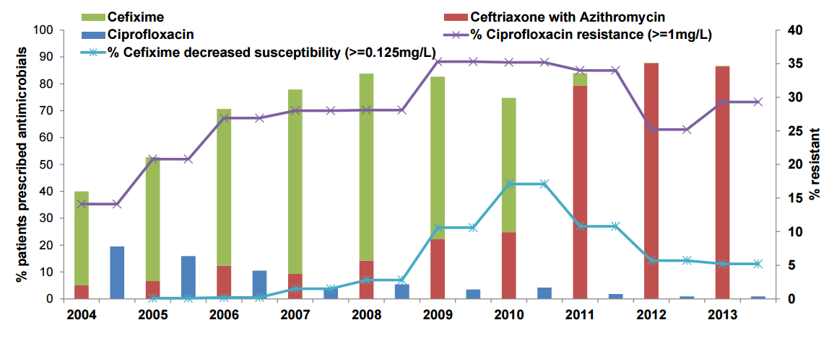

Background
Antimicrobial prescribing practice. GRASP clinics: 2004-2014
GRASP: Gonococcal Resistance and Antimicrobial Susceptibility Programme

Slide 4
Rationale
Culture ⬇ Nucleic Acid Amplification Testing (NAAT) ⬆: There is a need for genotypic antimicrobial susceptibility testing
⬆ Point of care testing technology - Rapid antimicrobial susceptibility testing from clinical samples
Genotypic-phenotypic relationships:
  Penicillins / Cephalosporins ➡ Complex
  Ciprofloxacin / Azithromycin / Tetracycline ➡Better understood
  Targeted PCR for ciprofloxacin susceptibility is highly accurate (Pond et al. JAC 2016)
  As antimicrobial resistance genes evolve – Whole genome sequencing (WGS) may have utility in laboratory settings and if deployed as a rapid format on clinical samples
Pond et al. (2016) J. Antimicrob. Chemother. 71 (4): 897-902. Accurate detection of Neisseria gonorrhoeae ciprofloxacin susceptibility directly from genital and extragenital clinical samples: towards genotype-guided antimicrobial therapy.
Notes:
Rationale
Remove last bullet point – that is my aim

Slide 5
Aims
  To investigate the potential utility of whole genome sequencing for enabling tailored therapy of cephalosporin sparing/inclusive regimens, by evaluating its accuracy for predicting phenotypic susceptibility to:
  Ciprofloxacin
  Azithromycin
  Tetracycline

Slide 6
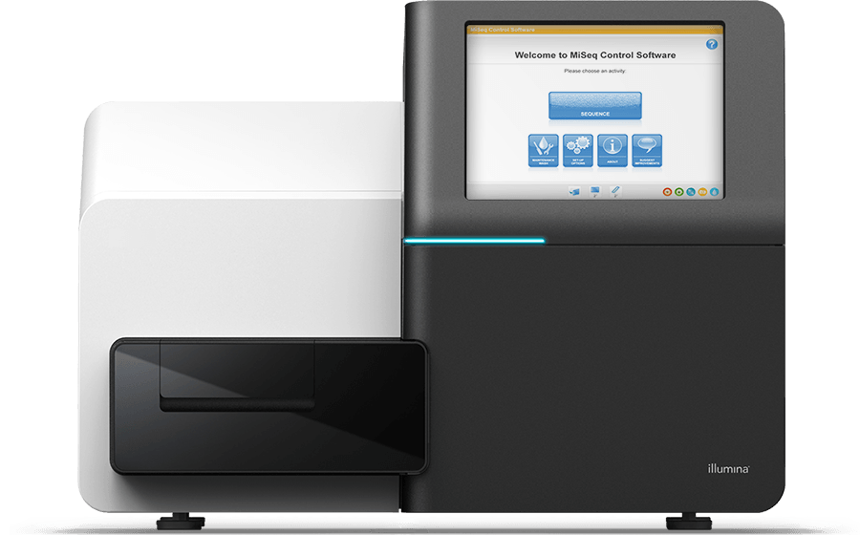
Methods
57 consecutively collected NG positive GRASP isolates from St George’s University Hospitals NHS Foundation Trust in 2013
DNA extracted and library prepped for Illumina Miseq - Genome sequences aligned and assembled
Sequence data interrogated for antimicrobial resistance associated single nucleotide polymorphisms (SNPs) and genes
Phenotypic data defined by EUCAST breakpoints.

Slide 7
Resistance Associated Genes
Ciprofloxacin | Azithromycin | Tetracyclines
Gene SNP gyrA: S91F D95N D95G parC: D86N S88P E91K G85C S87I S87N S87Arg E91G R116L | Gene SNP 23s rRNA: C2611T A2059G mtrR: G45D -35A- ermB gene ermF gene | Gene SNP mtrR: G45D -35A- porB: G120K G120D/A121D A121N rpsJ: V57M pilQ: E666K Tet(M) gene
These are previously defined SNPs that have been reported (Unemo et al. CMR 2014)
Genotypic susceptibility defined as the complete absence of SNPs or resistance genes
Unemo M, Shafer W,M. (2014) Clinical Microbiology Reviews 27 (3): 587-613. Antimicrobial Resistance in Neisseria gonorrhoeae in the 21st Century: Past, Evolution, and Future.
Notes:
Add column, gene and SNP heading
These are already defined SNPs that have previously been reported – put as a bullet point and (unemo, et al)
Be more brief on this slide

Slide 8
Sample details
Age group range 16-55 years
Range of sample types: urethral (M23,F2), pharyngeal (M6,F1), rectal (M15,F1) and cervical swabs (F9).
77% from men and 23% from women
MIC breakpoints used:
Ciprofloxacin | S ≤ 0.03mg/L | R > 0.06mg/L
Azithromycin | S ≤ 0.25mg/L | R > 0.5mg/L
Tetracycline | S ≤ 0.5mg/L | R > 1mg/L
http://www.eucast.org/clinical_breakpoints/

Slide 9
Results
Antibiotic | Phenotypically Susceptible N | Genotypically susceptible N | Susceptible MIC | PPV of absence of markers for susceptibility (95% CI) | Sensitivity (95% CI) | Specificity (95% CI)
Ciprofloxacin | 41 | 40 | ≤0.03mg/L | 100% (91.2%- 100%) | 97.6% (87.4%- 99.6%) | 100% (80.6%- 100%)
Azithromycin | 50 | 25 | ≤0.25mg/L | 100% (86.7%- 100%) | 50% (36.6%- 63.4%) | 100% (86.7%- 100%)
Tetracycline | 8 | 7 | ≤0.5mg/L | 87.5% (52.9%- 97.8%) | 87.5% (52.9%- 97.8%) | 98% (89.3%- 99.6%)
Notes:
Put results numbers in this table instead of the slide before – 40/41
25/50
7/8
Explain why sensitivity is only 87.5% for tetracycline here

Slide 10
Potential for Impact
Using Public Health England data: 34,958 NG positive diagnoses (PHE, 2015), combined with GRASP data (GRASP, 2015):
  21,918 (62.7%) ciprofloxacin susceptible
    WGS sensitivity =97.6%
    21,391 (61.2%) ciprofloxacin susceptible patients could be treated with ciprofloxacin, as single or adjunctive therapy
  34,608 (99%) azithromycin susceptible
    WGS 50% sensitivity
    17,304 (49.5%) azithromycin susceptible patients could be treated with azithromycin as single or adjunctive therapy
Data are not yet sufficient for tetracycline use based on a PPV of 87.5%
PHE (2015) Sexually transmitted infections and chlamydia screening in England, 2014
GRASP (2015) Surveillance of antimicrobial resistance in Neisseria gonorrhoeae. Key findings from GRASP and related surveillance data 2014

Slide 11
Conclusions
The PPV of the absence of genetic resistance markers for predicting susceptibility was most accurate for ciprofloxacin and azithromycin but less so for tetracycline phenotypic susceptibility.
If validated on NG NAAT positive samples, WGS may allow for new precision cephalosporin-sparing or adjunctive treatment combinations, for a substantial proportion of patients.
Notes:
Mention this is in terms of PPV and not sensitivity?

Slide 12



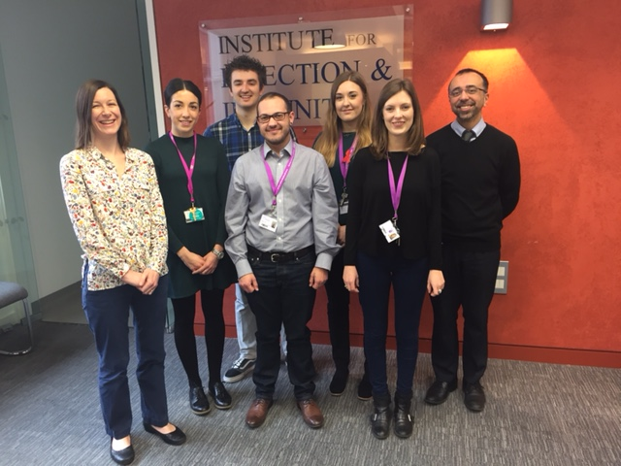

Acknowledgements
GRASP – Dr Gwenda Hughes; Professor Cathy Ison; Dr Michelle Cole
The ADREU team at SGUL
Departments of Microbiology and GUM,
St George’s Hospital
Notes:
ADREU photo
Acknowledge UK CRC, funded by welcome, NIHR and MRC

