Slide 1
Are geosocial networking (GSN) apps associated with increased risk of STI & HIV? A systematic review
Matheus Almeida – Queen Mary University of London Undergraduate
Prof Claudia Estcourt – Research supervisor. Queen Mary University of London
BASHH Annual Conference 2016
Notes:
Good afternoon, thank you for the opportunity to present this work which I have done as a visiting medical student from Brazil under the supervision of Prof Claudia Estcourt

Slide 2
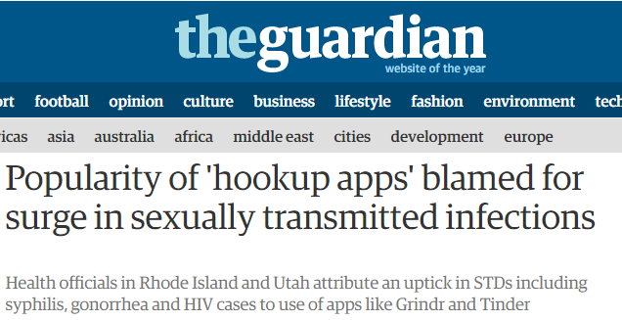
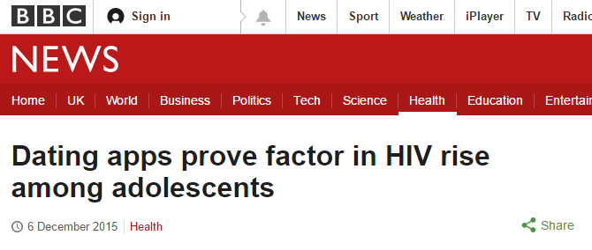
Introduction
Media across the world have been quick to assert that use of apps is associated with a higher risk of STI & HIV
Notes:
-Over the last few years, the media has been quick to affirm that “dating apps” are to blame for the recent increase in HIV and other STIs.

Slide 3
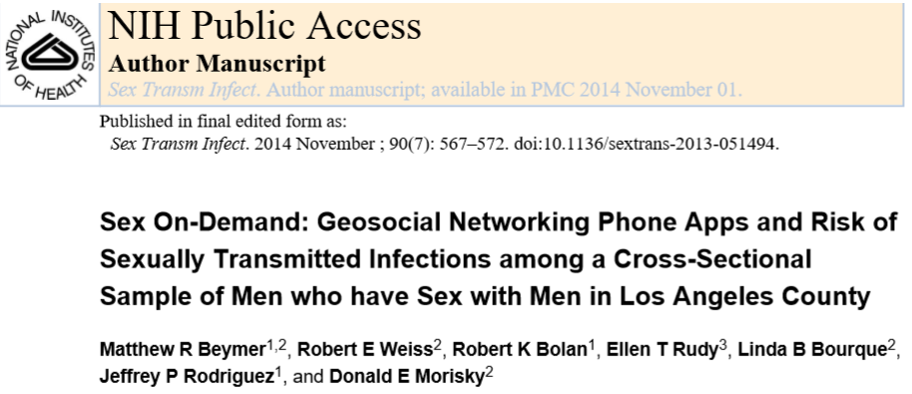
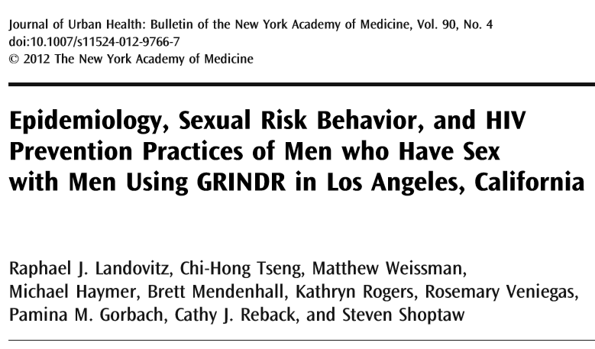
Introduction
Published literature linking use of apps to risky sexual behaviours first emerged around 2012
Notes:
Scientific reports suggesting a link first appeared in 2012.

Slide 4
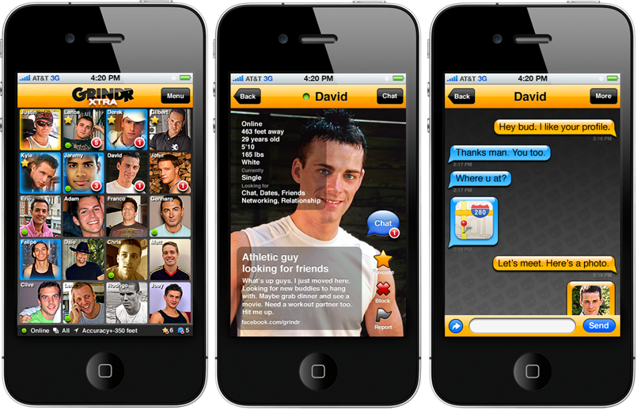
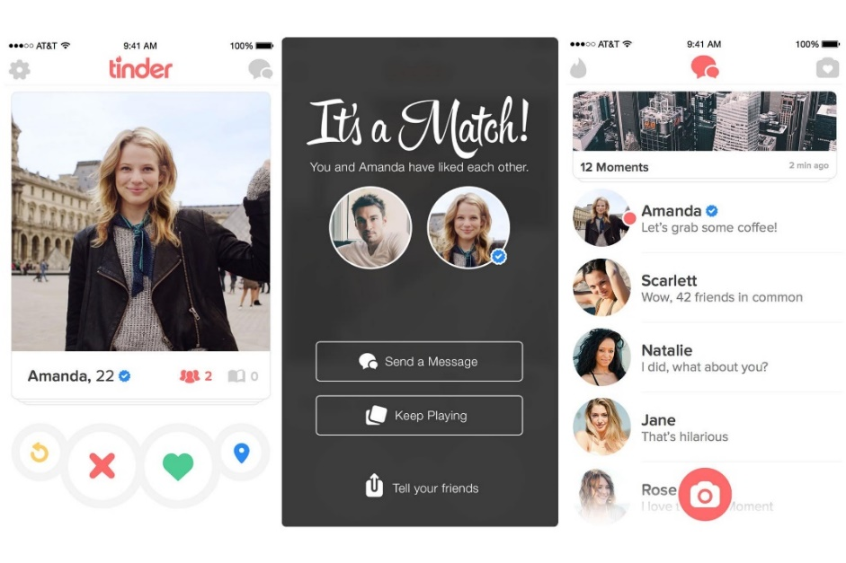
Emergence of GSN apps
Uniqueness of apps compared to other social networking methods (in person, websites)
Shorter period of time from choosing a partner to meeting in person, facilitating sexual encounters
Easier to choose from a variety of profiles
Notes:
As you have heard in dr ******** talk, GSN apps make finding sexual partners very easy.
Some are explicitly marketed for sex seeking and others enable users to specify what they`re looking for in terms of relationship, or sex or both.
The novel feature about these apps is the geographical filter, enabling a user to find partners very close by.

Slide 5
How could GSN app use influence epidemiology of STI & HIV?
Increase rate of partner change
Encourage/facilitate unprotected sex
Chemsex and alcohol
Facilitate sexual concurrency, expanding the network of infection
Notes:
-So in what ways how could these apps actually interfere in HIV and STI epidemiology?
More partners
Unprotected sex
Substance use
Overlapping partnerships

Slide 6
How could GSN app use influence epidemiology of STI & HIV?
Increase rate of partner change
Encourage/facilitate unprotected sex
Chemsex and alcohol
Facilitate sexual concurrency, expanding the network of infection
Aim: to explore whether use of GSN apps is associated with increased risk of STIs and HIV by evaluating available evidence base
Notes:
-So in what ways how could these apps actually interfere in HIV and STI epidemiology?
More partners
Unproetcted sex
Substance use
Overlapping partnerships

Slide 7
Methods
Systematic review of published literature, 2009 to 29th February 2016
Defined increased risk:
Condomless sex
Number of sex partners
Previous or current STIs and HIV, reported or detected at time of survey
Chemsex and/or alcohol
Sexual concurrency
Notes:
-To assess that, we conducted a systematic review of the published literature from 2009, that is when these apps first emerged, to the end of February 2016.
-In the first place, we defined increased risk for HIV and STI so we know what we are looking for.
Unprotected sex
Number of sex partners (kept this open to keep search results broad)
Previous or current STIs and HIV, which could be reported or detected at time of survey
Chemsex and alcohol
Sexual concurrency

Slide 8
Methods
Sources: Pubmed, EMBASE, Google Scholar
Search Terms: geosocial apps, geosocial networking, geosocial networking apps, Grindr, Tinder, combined (“AND”) with at least one of the following: sexual behaviour, internet sex seeking, mobile app, mobile dating, HIV risk behaviours, HIV, STIs, sexually transmitted infections, sexual partners, condom use, chemsex
Data extraction form (PRISMA and Cochrane Consumers & Communication Review Group) (http://researchguides.ebling.library.wisc.edu/systematic-reviews/author/data)
Critical Appraisal Skills Programme (http://www.casp-uk.net)
Data extracted by one researcher (MA) and sample checked by a second researcher and discrepancies discussed
Notes:
-We searched the online databases Pubmed, EMBASE and Google scholar. We looked for search terms associating at least one search term regarding the apps themselves with another regarding one of our defined increased risks.
-To extract data from each study, we used a data extraction form adapted from PRISMA and the Cochrane group to fit our purposes
-Appraisal of the papers was guided by the CriticalAppraisal Skills Programme
-The data was extracted by me and the sample was checked by my supervisor and we discussed any discrepancies.

Slide 9
Results: Flow Diagram
Full-text articles assessed for eligibility
(n=31)
Studies included in data synthesis (n=15)
Records identified through database screening (n=47)
Records screened
(n=47)
Records after duplicates removed
(n=47)
Additional records identified through other sources (n=0)
Records excluded
(n=16)
Full-text articles excluded (n=16)(no data on sexual risks)
Identification
Screening
Eligibility
Included
Notes:
-The database search turned up 47 records, for which 16 were excluded during screening, and then 16 more were excluded for eligibility for data analysis because they did not report data on any of our risk definitions, leaving us with a total of 15.

Slide 10
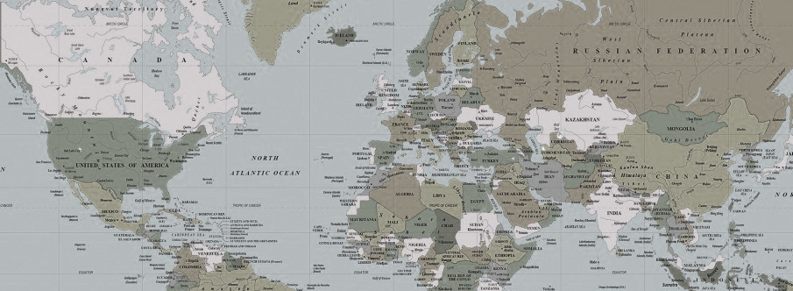
Results: Study Characteristics
15 studies included for data analysis
1
11
1
1
1
Notes:
-So we had 15 studies included in data analysis.
-Eleven of them from the USA, 1 from the UK, 1 from China, 1 from Hong Kong and another 1 from Taiwan.

Slide 11
Results: Study Characteristics
All MSM and cross-sectional surveys in urban areas
8 describe behaviours in app user, and 7 compare app users with non app users
Different recruitment methodology across studies (8 online only, 5 online and in-venue, 2 from public health services)
Number of participants ranged from 92 to 7184
Notes:
-All these studies were on men who have sex with men, designed as cross-sectional surveys and performed in urban areas.
-However, there were considerable differences in recruitment methodology and number of participants.

Slide 12
Results: Unprotected anal intercourse
Nº of studies | UPAI (% respondents)
 | Last sex | Last 3 months | Last 6 months | Last year
3 (USA) (Holloway et al. 2015; Rice et al. 2012; Winetrobe et al. 2014) | 19.8-29.0
3 (USA) (Landovitz et al. 2012; Rendina et al. 2014; Grosskopf et al. 2014) |  | 46.1-66.7
2 (USA, Hong Kong) (Goedel et al. 2016, Yeo et al. 2015) |  |  | 25.4-40.2
1 (UK & Ireland) (Lorimer et al. 2015) |  |  |  | 48.5
Notes:
-It was very difficult to compare rates of unprotected anal sex between studies because they used different measures and time periods. However, high rates of unprotected sex were reported, for example, in Lorimer study almost half of men reported unprotected anal sex in the last year.
SPLIT UPAI AND TIME PERIODS

Slide 13
Results: Number of sexual partners (descriptive)
Study | Last 1 month | Last 3 months | Last 6 months
Winetrobe et al. 2014 (USA) | Mean: 2.33 (SD 3.35)
Landovitz et al. 2012 (USA) |  | Mean: 3.8 (SD 7.2).
Lehmiller et al. 2014 (USA) |  | Mean: 4.84; Median: 3.00
Rendina et al. 2014 (USA) |  | Median number of male partners: 4.0 (IQR=2,8)
Goedel et al. 2016 (USA) |  |  | 64.1% participants had at least 1 male anal sex partner.
Yeo et al. 2015 (Hong Kong) |  |  | 57.8%: 1-3 sex partners; 28.9%: >3 sex partners.
Notes:
(DESCRIPTIVE)
-Now, considering number of sexual partners… again, it was very difficult to compare studies.
I will show you two slides. The first one is descriptive studies, and the second compares app users and non users.
-For this one, the overall message is that men are reporting high number of sex partners

Slide 14
Results: Number of sexual partners (app users vs. non users)
Study | Last 3 months | Last 12 months
Bien et al. 2015 (China) | Users were nearly 2 times more likely to have had at least 2 sex partners compared to non-users.
Holloway et al. 2015 (USA) | App users had statistically significantly higher number of partners (3 months and lifetime) .(t=3.315, p<0.01)
Phillips et al. 2014 (USA) |  | App users were less likely to have fewer than 5 male sex partners (vs. 5 or more).
Notes:
-When app users and non app users are compared, we consistently see a higher number of reported sex partners among app users

Slide 15
Results: Prevalence of HIV
Study | Setting | HIV prevalence (%) | Ascertainment
Phillips et al. 2014 | USA | 11.4 (26/379) | Reported
Goedel et al. 2016 | USA (Atlanta, Georgia) | 8.7 (8/92) | Reported
Holloway et al. 2015 | USA (LA, California) | 7.34 (17/295) | Reported
Landovitz et al. 2012 | USA (LA, California) | 4.5 (17/395) | Reported
Lehmiller et al. 2014 | USA | 3.4 (4/110) | Reported
Beymer et al. 2014 | USA (LA, California) | Not presented | Tested
Bien et al. 2015 | China | 3.7 (49/1342) | Reported
Ko et al. 2016 | Taiwan | 8.3 (88/1060) | Reported
Notes:
((order USA ones in date order))
The HIV prevalence varied between studies from 3.4% to 11.4%
Beymer et al. was the only study which tested for HIV rather than using participant-reported outcomes. This study was a large comparative study, but they didn`t present the test findings in the paper.

Slide 16
Results: Prevalence other STIs
5 studies reported data on STI prevalence/incidence
3 out of these 5 studies found that app users were more likely than non-users to have had an STI
Notes:
((order USA ones in date order))
The HIV prevalence varied between studies from 3.4% to 11.4%
Beymer et al. was the only study which tested for HIV rather than using participant-reported outcomes. This study was a large comparative study, but they didn`t present the test findings in the paper.

Slide 17
Results: Chemsex and/or alcohol use
STUDY | COUNTRY | Chemsex
Landovitz et al. 2012 | USA | 180/375 (48%) drugs or alcohol during sex in past month
Winetrobe et al. 2014 | USA | 42/146 (28.8%) drugs or alcohol during sex with last Grindr-met partner
Yeo et al. 2015 | Hong Kong | 17/213 (8.0%) drug use during sex in past 6 months
Notes:
Again, the 3 studies that reported substance use used different time measures and both the USA studies reported drug or alcohol use but the Hong Kong study reported just drugs use so it is difficult to draw conclusions

Slide 18
Conclusions and recommendations
GSN App use appears to be associated with increased risk of UAI and higher number of sex partners in MSM.
No studies on heterosexuals which met inclusion criteria
Strengths: first study to undertake a systematic approach to review
Limitations: methodology varied across studies, making comparisons difficult. Mostly USA & urban, so may not be generalisable to other settings

Slide 19
Conclusions and recommendations
GSN App use appears to be associated with increased risk of UAI and higher number of sex partners in MSM.
No studies on heterosexuals which met inclusion criteria
Strengths: first study to undertake a systematic approach to review
Limitations: methodology varied across studies, making comparisons difficult. Mostly USA & urban, so may not be generalisable to other settings
Consistency in measuring & reporting of sexual & other risk behaviours, and STI/HIV
Studies which focus on heterosexuals
Notes:
Consistency IS NEEDED

Slide 20
Acknowledgements
It has been a great pleasure to carry out this study as my final work in the Infectious Diseases and Epidemiology iBsc at Queen Mary, University of London. I am thankful for the Science without Borders programme by the Brazilian Government and National Council of Technological and Scientific Development scholarship. Many thanks go to Dr. Matthias Dittmar, for picking me as one of his international students and providing a complete and overview of human infection. I am especially thankful for having Prof. Claudia Estcourt as my research supervisor, as well as her team at Barts and the London School of Medicine and Dentistry. She has given me outstanding guidance, excellent thought provoking into the subject, and was essential to the completion of my work.
Notes:
Thank you for your time and attention.
---------------------------------------------------------
Questions: how does a systematic review differ from a comprehensive review?
How would you design a study for heteros
Could you do a meta analysis?
UPOI

